Slide 1

Quality analysis of red wine
Introduction to Statistical Computing (1001) (Dr. Zhijian LI) [Semester 2 of 2021-2022] Computing
Group 1
Andi 1930026063
David 1930006138
Justin 1930026081

Slide 2

PART 01
Introduction
PART 02
Data analysis
Content
PART 03
Modeling
PART 04
Simulation
PART 05
Conclusion

Slide 3
1. Introduction

Slide 4

Data Introduction
Y
Motivation
Quality
Based on sensory data
Explore the important physical and chemical properties of red wine
10
9
Very excellent
8
7
Good
6
Sources
5
Normal
4
3
poor
2
1
Very poor
Notes:
Our group project aims to explore the important physical and chemical properties of red wind. Firstly, our red wind data is from Kaggle. Then our dependent variable is quality. The higher the score, the higher the wine quality, the lower the score, the lower the wine quality. In the following data analysis, we set the score >= 7 as good red wine. Scores below 7 are common or poor quality red wine.

Slide 5
Attributes of X
Acid indicators
Others indicators
Fixed Acidity
It can be tasted in the mouth.
Ex: tartaric acid, malic acid
Residual Sugar
Sugar remaining
Density
The degree to which fructose is converted to alcohol concentration
Volatile Acidity
It can be smelled.
Ex: acetic acid, lactic acid
PH
PH value
Citric Acid
The same as fixed acidity and volatile acidity, but it exists in small quantities
Alcohol
Alcohol concentration
Notes:
Residual Sugar: Important ingredients for flavor balance. Ex: glucose, fructose
Alcohol: Moderate alcohol content to ensure a balanced wine structure

Slide 6

Objective
What is the difference between a high-rated red wine and a low-rated red wine?
To what extent do the physical and chemical properties of red wine determine the quality of red wine?
Notes:
So our group asked two questions.

Slide 7
2. Data Analysis

Slide 8
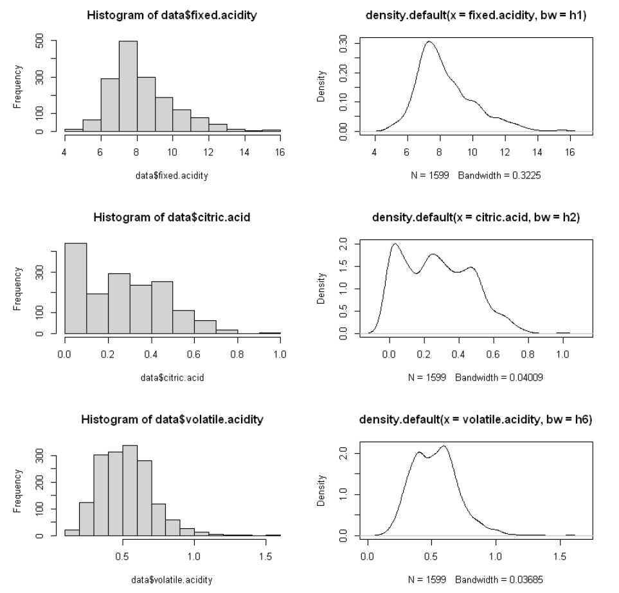
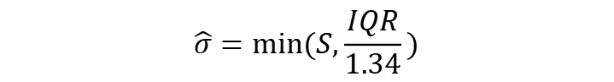
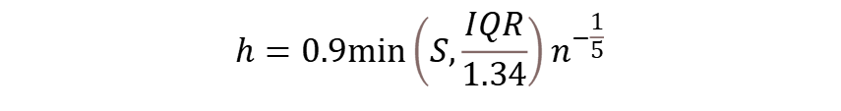
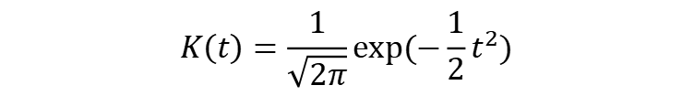
Histogram and Kernel density estimates
Gaussian Kernel
$$K\left(t\right)=\frac{1}{\sqrt{2π}}exp⁡(−\frac{1}{2}t^{2})$$
For unimodal distribution
$$h=0.9\min\left(S,\frac{IQR}{1.34}\right)n^{−\frac{1}{5}}$$
For not unimodal distribution
$$\hat{σ}=min⁡(S,\frac{IQR}{1.34})$$
Acid Attributes
Notes:
Here shows the histogram and kernel density estimates for variables.
For all attributes, we use gaussian kernel to estimate kernel density.
For unimodal distribution, we set h =
In addition, for not unimodal distribution, we need to set sigma =

Slide 9
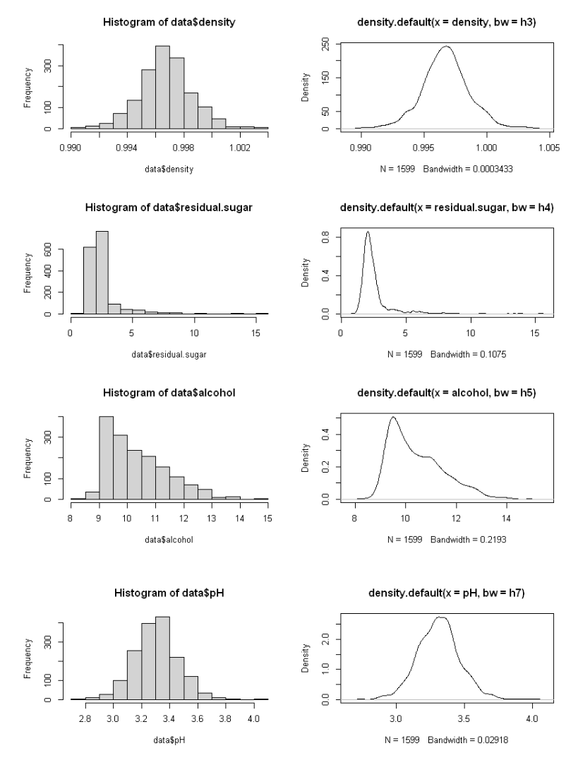
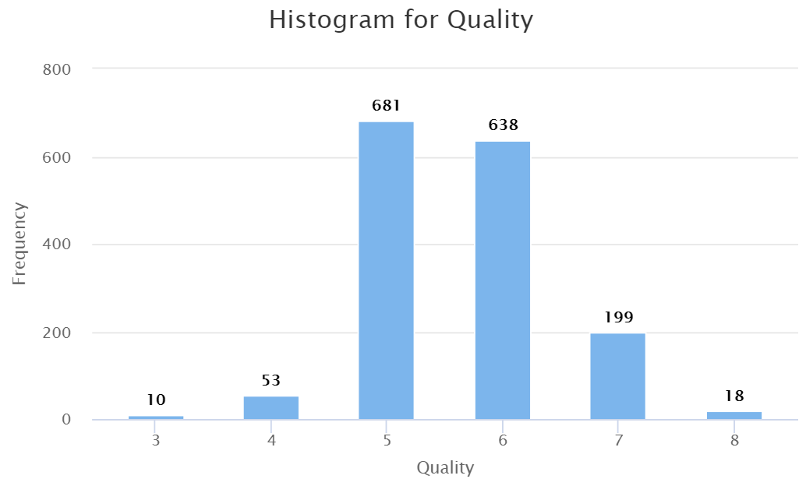
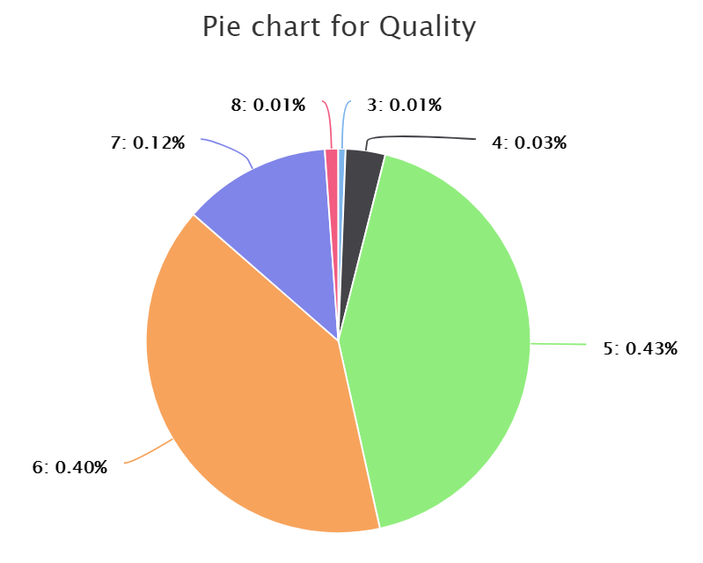
Dependent Variables
Other

Slide 10
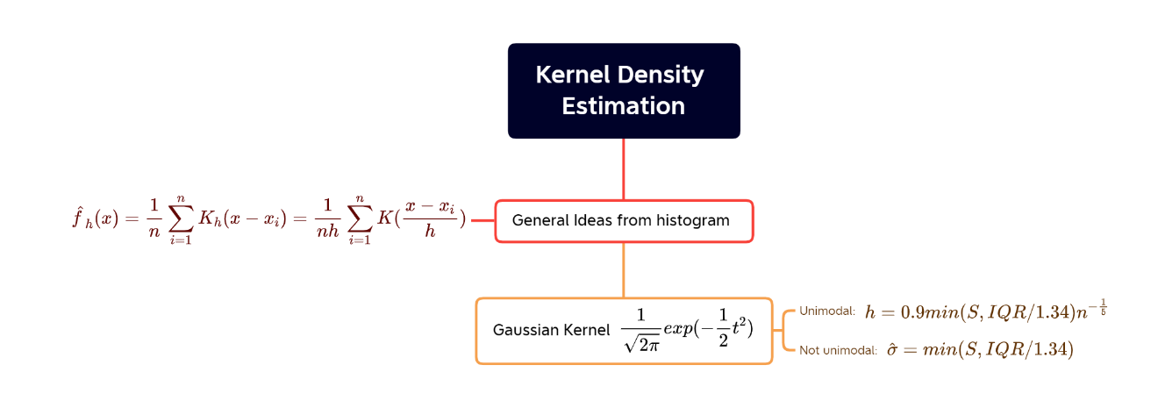
Kernel Density Estimation
Notes:
Kernel density estimation is used in probability theory to estimate the unknown density function, which belongs to one of the non-parametric test methods. Since the kernel density estimation method does not use prior knowledge about the data distribution, it does not attach any assumptions to the data distribution. The method of studying the characteristics of data distribution from the data sample itself.
The ideas of Kernel Density Estimation are generated from histogram. If we draw a histogram, the purpose is to draw a "probability density function", and a histogram essentially thinks that frequency equals probability. But this assumption is not inevitable. The kernel density function is a means of "smoothing". Let $(x1,x2,…,xn)$be n sample points that are independent and identically distributed, and its probability density function is f, so our estimate: $\hat{f_{h}}\left(x\right)=\frac{1}{nh}\sum_{i=1}^{n}{K(\frac{x−x_{i}}{h})}$. Here h is the bandwidth. For Gaussian Kernel, if the distribution is unimodal, we need to set $h=0.9\min\left(S,\frac{IQR}{1.34}\right)n^{−\frac{1}{5}}$. In addition, if the distribution is not unimodal, we need set $\hat{σ}=min⁡(S,IQR/1.34)$.

Slide 11
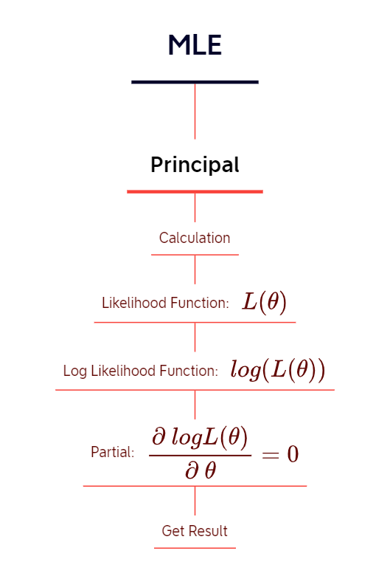
Maximum likelihood Estimation
Notes:
The Maximum Likelihood Estimation method to estimate the value of the most likely parameter by finding the maximum likelihood. For calculation, you need you need product the all observed sample. After defining the Likelihood Function, we take the logarithm of likelihood function. Because the monotonicity of the logarithm does not change the monotonicity of the likelihood formula, and both take the maximum value at the same point. Finally, derive the parameters and set the equation to zero to get the estimated value.

Slide 12
Estimate mean and variance
EM
Attributes | Jackknife | Bootstrap | MLE | Sample
Fixed acid | (8.32,3.03) | (8.27,3.02) | (8.32,3.03) | (8.32,3.03)
Citric acid | (0.27,0.038) | (0.27,0.039) | (0.27,0.038) | (0.27,0.038)
density | (0.997,3.56e-6) | (0.997,3.50e-6) | (0.997,3.56e-6) | (0.997,3.56e-6)
Residual sugar | (2.54,1.99) | (2.54,2.13) | (2.54,1.99) | (2.54,1.99)
alcohol | (10.42,1.14) | (10.42,1.08) | (10.42,1.13) | (10.42,1.14)
Volatile acid | (0.528,0.032) | (0.523,0.032) | (0.528,0.032) | (0.528,0.032)
pH | (3.311,0.024) | (3.317,0.023) | (3.311,0.024)) | (3.311,0.024))
Notes:
The table conclude the estimate mean and variance by different estimation methods. We round all the information in the table, some estimated parameters may look the same on the graph but they are not. For Bootstrap method, we set $B=2000$. Because the bootstrap is randomly selected sample, so each time the estimated value is different. For another sample method, the estimates returned by jackknife each time have little error with the total sample estimates. For most distributions, we assume that they are normal distribution, we use MLE to estimate the parameter. But it is worth nothing that estimated value by MLE is biased. So, a few decimal places will be different from jackknife's result, but the graph doesn't provide enough information to prove it. Meanwhile we use EM algorithm to estimate “citric acid” attributes, the results are similar to the sample method results, indicating that our EM algorithm converges to a good result.

Slide 13
3. Modeling

Slide 14
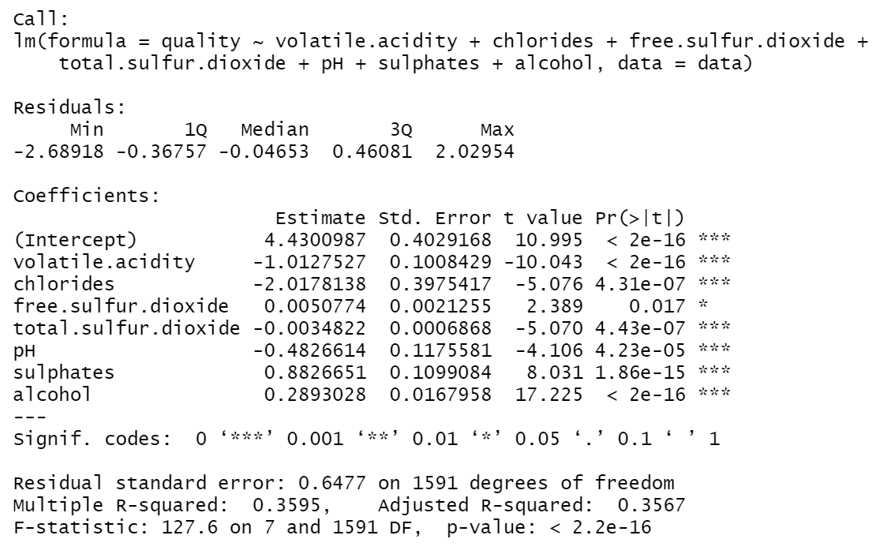
Linear model building
Step
Notes:
Then we make a modeling for these data. We conduct the easiest way for linear regression, which is using step function. And the final result can be seen as follows, which is not the main part for us. The result can be used a reference

Slide 15
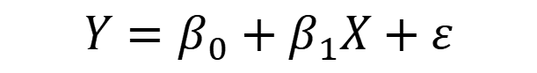
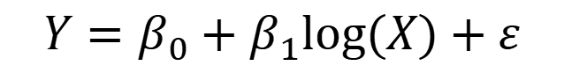
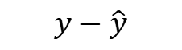
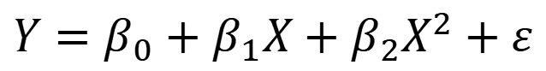
Model selection by Jackknife
1. Linear:
$$Y=β_{0}+β_{1}X+ε$$
2. Quadratic:
$$Y=β_{0}+β_{1}X+β_{2}X^{2}+ε$$
3. Log:
$$Y=β_{0}+β_{1}log⁡(X)+ε$$
Model selection by Jackknife
X
X
X
X
X
…
Y
Y
Y
Y
Y
…
X
X
X
X
X
…
Y
Y
Y
Y
Y
…
Grid search
for each column
LM function
Min predict error
$$y−\hat{y}$$
Notes:
We mainly focus on using jackknife to select the model. The workflow is to mask one of the data one by one in order. We just select one of the variables each search. For each mask, we use the remaining data for building model. And then use the data being masked to make prediction, and get the error of it.
The best variable with the best model has the lowest error square mean.

Slide 16
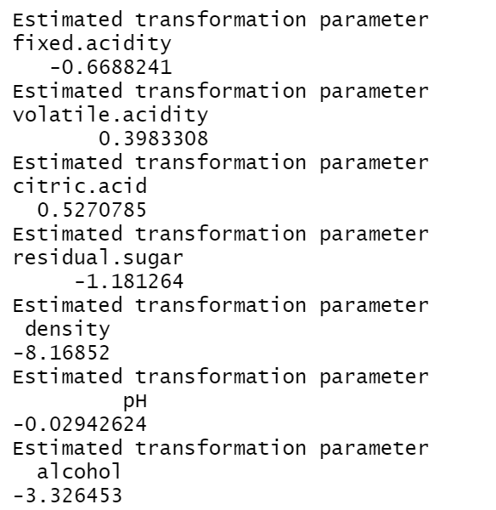
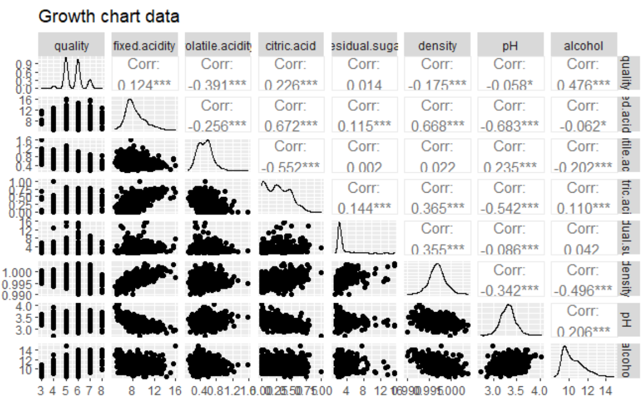
Model selection by Jackknife
Notes:
The result of the power Transformation of the variable and the distribution of the data with quality are important references when we manually filter variables. Apart from select by hand, we also try to use another method.

Slide 17
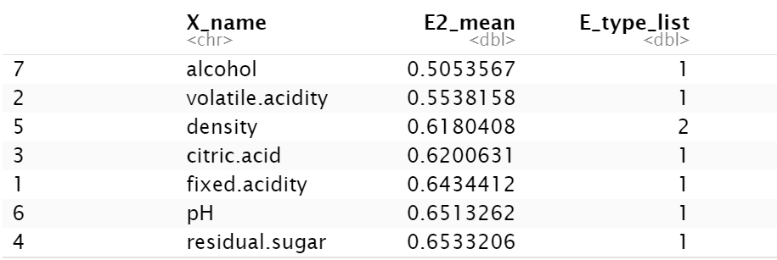
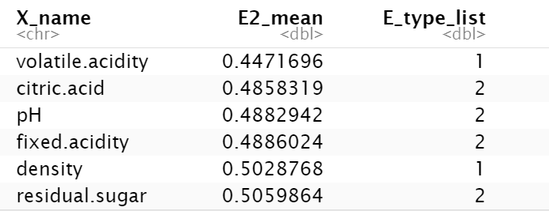
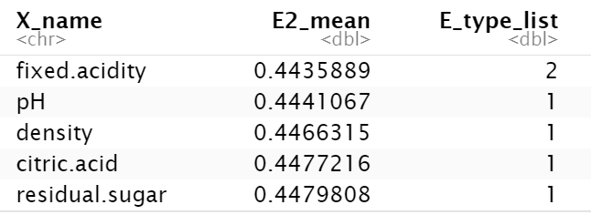
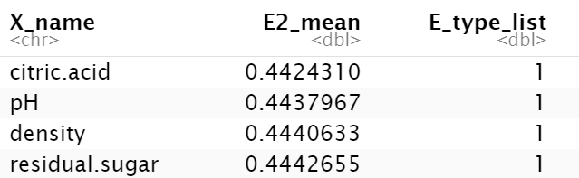
Model selection by Jackknife
Add variables base on the pervious model
Alcohol
Final model with four variables
Volatile.acidity
Quality
Fixed.acidity and Fixed.acidity^2
Citric.acid
Notes:
Besides, for every independent variable, we apply the grid search to obtain the most suitable variable with the following models, which is searching one by one with the following form. After we get the best one, we continuing adding new variable to conduct another operation to find the next variables and the model. The ranking is shown in here, 1 means the linear form and 2 means the quadratic form.

Slide 18
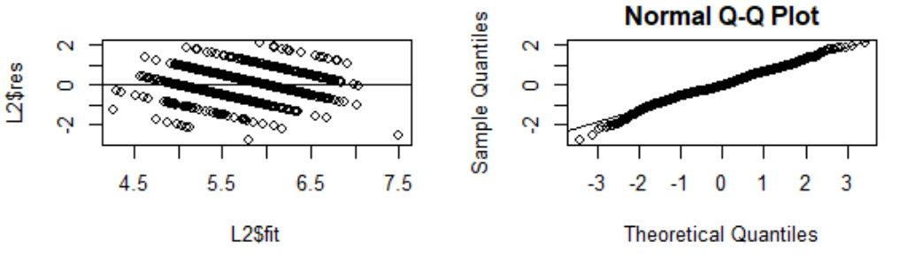
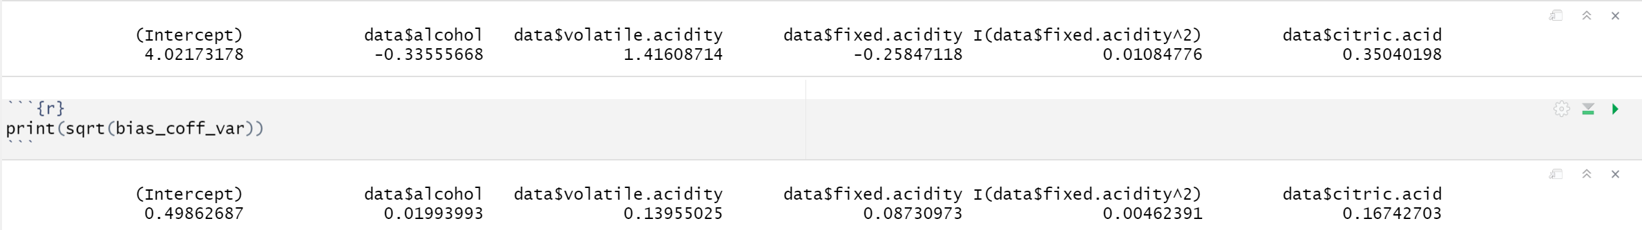
Model performance
Model performance
*Bootstrap for the bias and standard error of estimator
1. Using the sample directly
2. Build model by lm function
3. Get the coefficient
1. Generate sample from the sample we already have
Notes:
Finally, we get the following variables and the formula which is the best among the model we select. We then draw a graph to have a better view of the performance of the model. We can see that the QQ plot is mostly normal distribution, and the line is almost fit all the points.
Then we conduct the bootstrap method to get the bias and standard error of the estimator.
We use the sample as the original value of the estimator. And we use the bootstrap to generate a lot of samples to build model by lm and get new estimator. The result is listing here.

Slide 19
4. Simulation

Slide 20
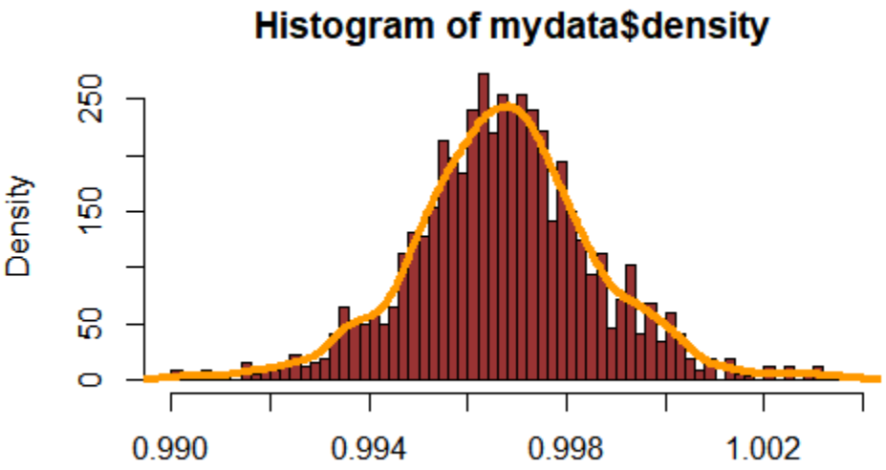
Assumption of The Model
The peak is in the middle
Both sides gradually decreasing
The two sides are nearly symmetrical
The ends do not intersect with the x-axis
Normally Distributed

Slide 21

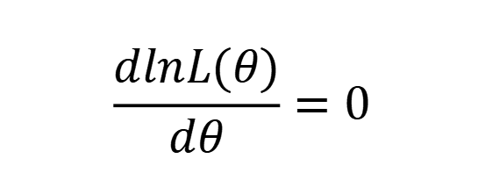
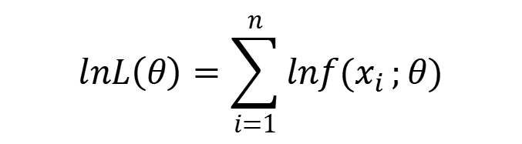
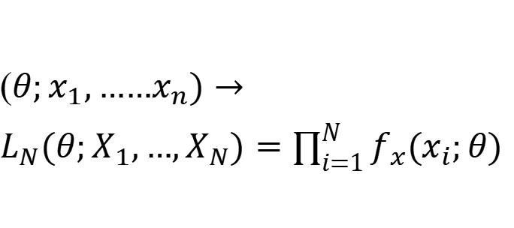
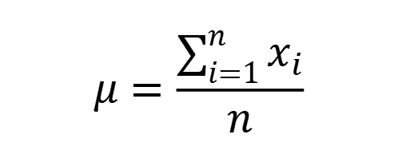
The MLE and Sample Method
The likelihood function is defined to be:
$L_{N}$: ΘX$R^{N}$→$R^{+}$
Step 1
$$μ=\frac{\sum_{i=1}^{n}{x_{i}}}{n}$$
Step 2
($θ;x_{1},……x_{n})→L_{N}(θ;X_{1},…,X_{N})=\prod_{i=1}^{N}{f_{x}(x_{i};θ)}$
Step 3
$$lnL\left(θ\right)=\sum_{i=1}^{n}{lnf(x_{i}};θ)$$
Step 4
$$\frac{dlnL(θ)}{dθ}=0$$

Slide 22
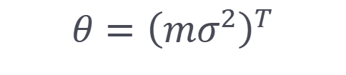
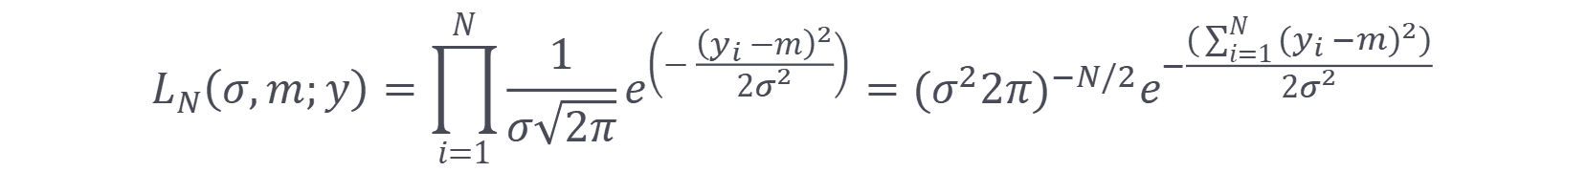
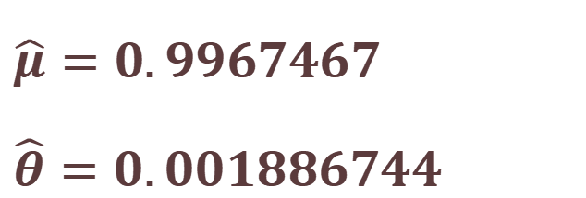
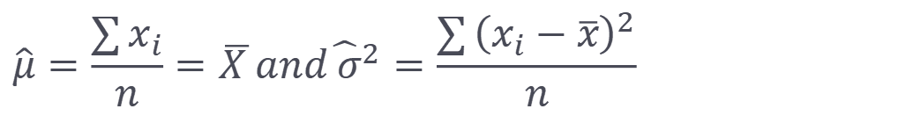
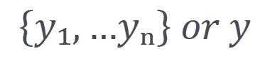
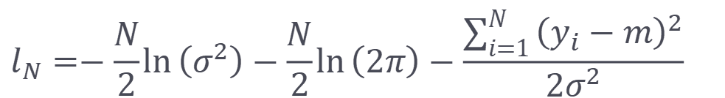
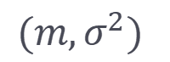
The MLE method
{Y₁,...,Yₙ}
N.i.d
$${(m,σ}^{2})$$
Denote the realisation by
The MLE
$$\left\{y₁,…yₙ\right\} or y$$
$$θ={\left(mσ^{2}\right)}^{T}$$
Define:
$$L_{N}\left(σ,m;y\right)=\prod_{i=1}^{N}{\frac{1}{σ\sqrt{2π}}e^{\left(−\frac{{\left(y_{i}−m\right)}^{2}}{2σ^{2}}\right)}}={(σ^{2}2π)}^{−N/2}e^{−\frac{(\sum_{i=1}^{N}{{(y_{i}−m)}^{2})}}{2σ^{2}}}$$
$$l_{N}=−\frac{N}{2}\ln\left(σ^{2}\right)−\frac{N}{2}\ln\left(2π\right)−\frac{\sum_{i=1}^{N}{{\left(y_{i}−m\right)}^{2}}}{2σ^{2}}$$
$$\hat{μ}=0.9967467$$
$$\hat{θ}=0.001886744$$
$$\hat{μ}=\frac{\sum{x_{i}}}{n}=\overline{X }and{\hat{ σ}}^{2}=\frac{\sum{{\left(x_{i}−\overline{x}\right)}^{2}}}{n}$$

Slide 23
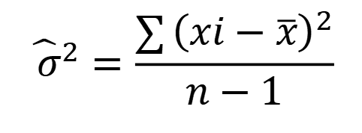
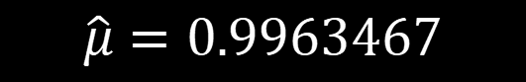
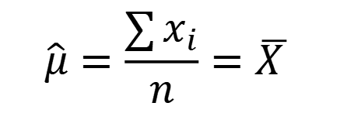
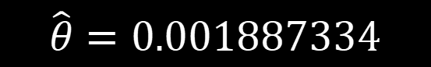
The Sample Method
$$\hat{μ}=\frac{\sum{x_{i}}}{n}=\overline{X }$$
$$\hat{μ}=0.9963467$$
$${\hat{ σ}}^{2}=\frac{\sum{{\left(xi−\overline{x}\right)}^{2}}}{n−1}$$
$$\hat{θ}=0.001887334$$

Slide 24
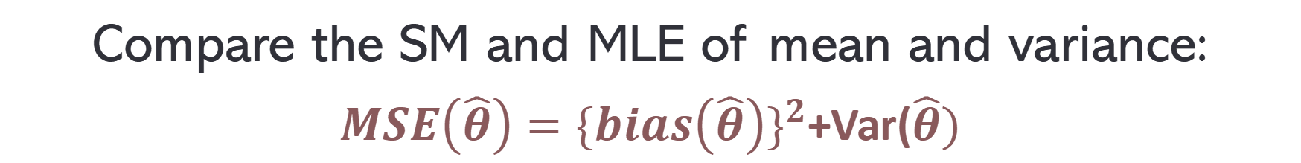
The MSE
Compare the SM and MLE of mean and variance:
$MSE\left(\hat{θ}\right)={\{bias\left(\hat{θ}\right)\}}^{2}$+Var($\hat{θ})$

Slide 25
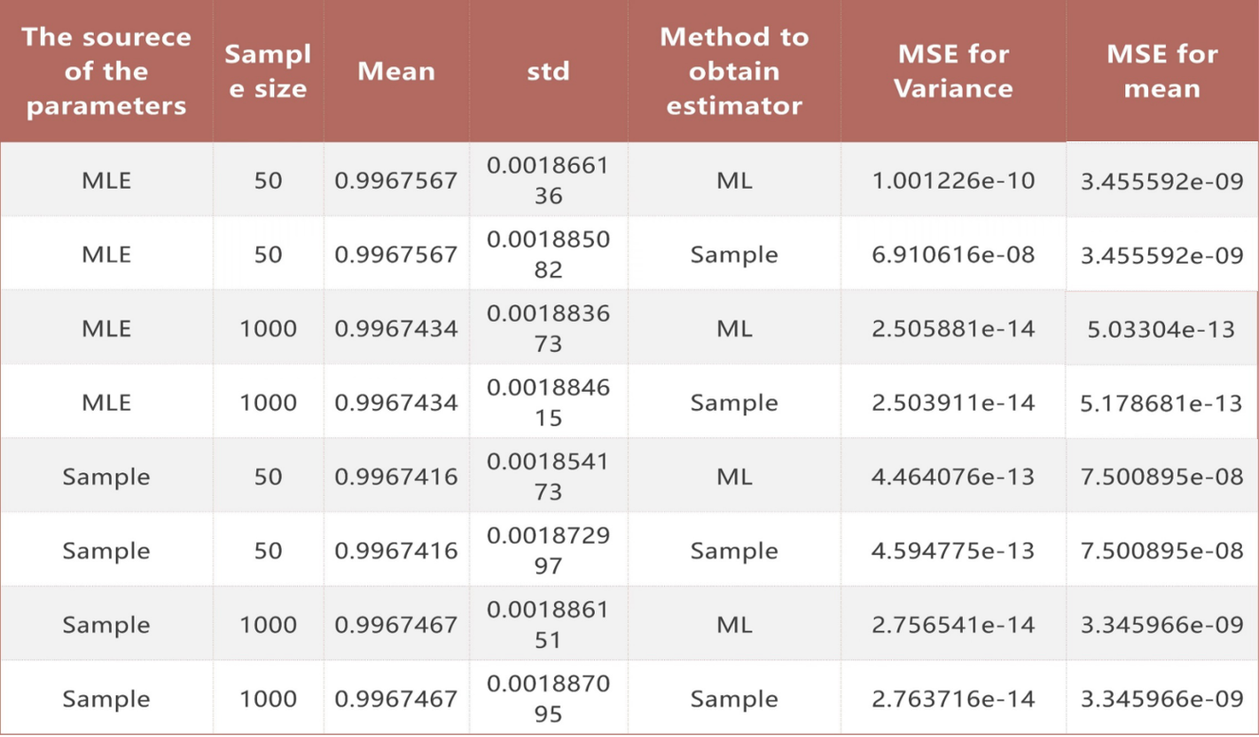
8 Groups of MSE /MEAN/STD in MC Simulation
二·输入内容
均可根据您的个人需要来进行一键替换。数据图表均可进行替换和编辑，根据需要进行设置。

Slide 26
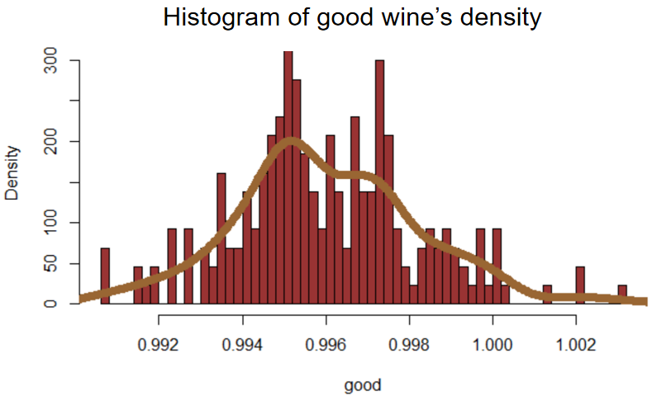
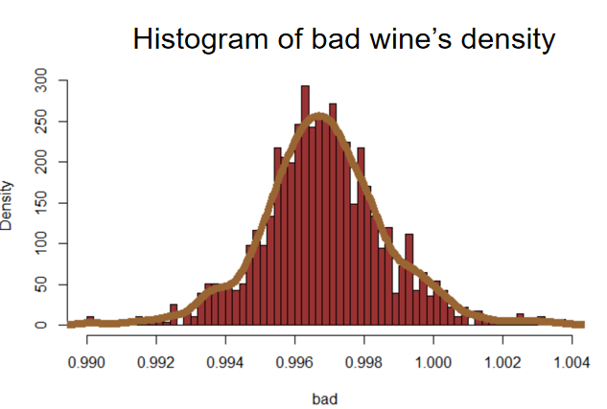
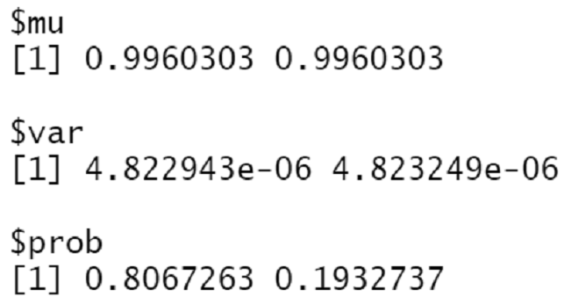
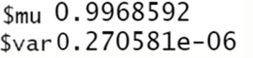
GOOD WINE && BAD WINE
Mixture Normal Distribution
Normal Distribution

Slide 27
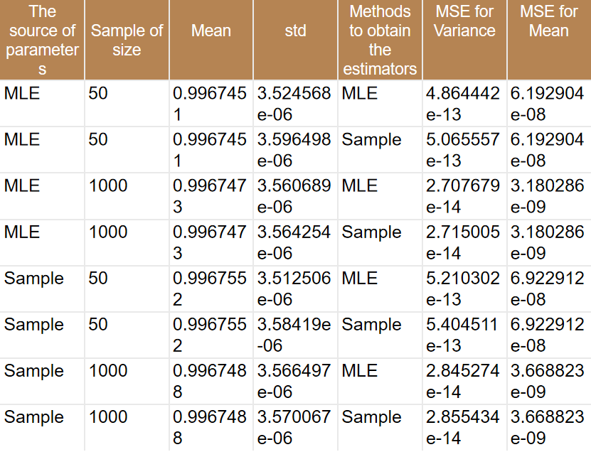

8 Groups of MSE /MEAN/STD in MC Simulation
二·输入内容
GOOD WINE
均可根据您的个人需要来进行一键替换。数据图表均可进行替换和编辑，根据需要进行设置。

Slide 28
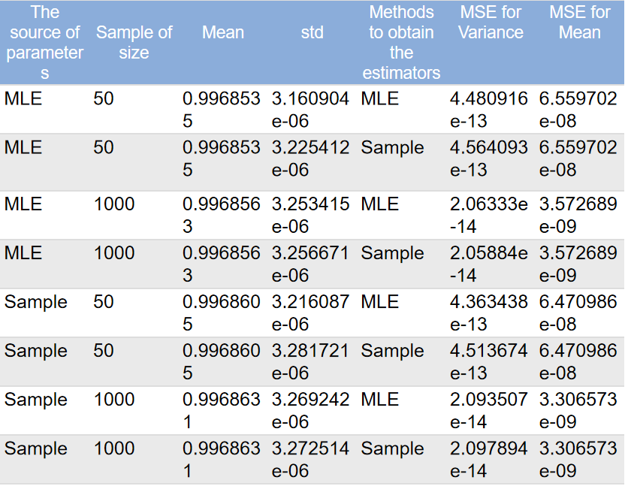

8 Groups of MSE /MEAN/STD in MC Simulation
二·输入内容
BAD WINE
均可根据您的个人需要来进行一键替换。数据图表均可进行替换和编辑，根据需要进行设置。

Slide 29
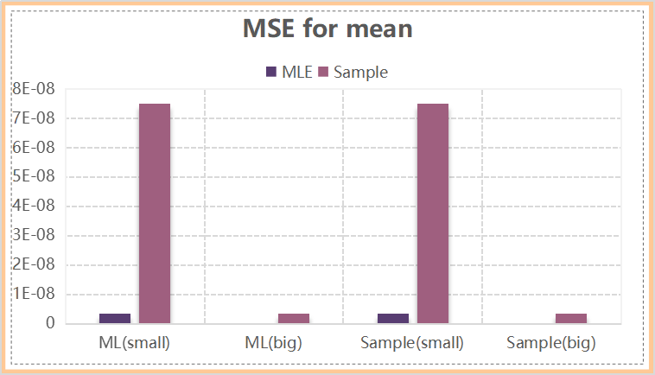
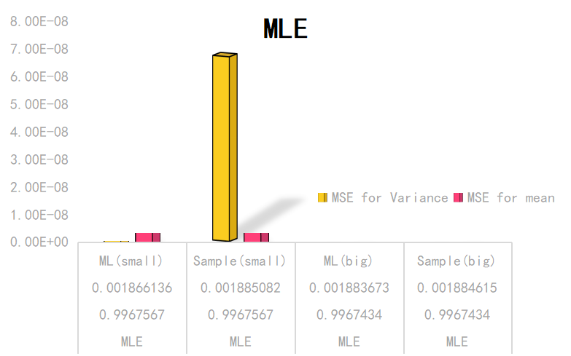
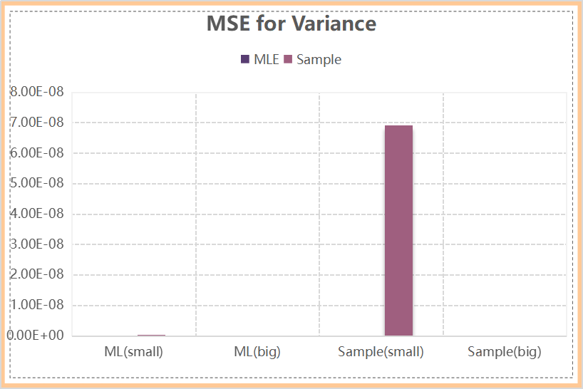
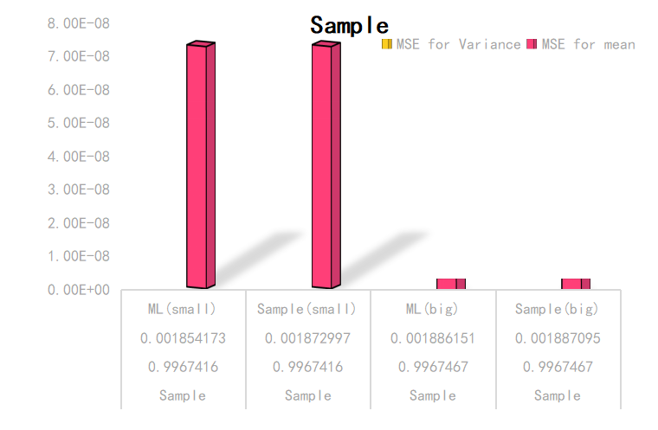

Compare and Conclusion
二·输入内容
均可根据您的个人需要来进行一键替换。数据图表均可进行替换和编辑，根据需要进行设置。

Slide 30
5. Conclusion

Slide 31

Different between bad-rated and good-rated wine

Slide 32
Reference
[1] Amparo Ffister-Sabater ,Pedro Garcfa-Mochales. On the balancedness of nonlinear generators of binary sexluenccs. Information Processing Letters. 2003, 85(2):ll I一1 t6
[2] R.E.Bellman, L.A.Zadeh. Decision making in a fuzzy environment Tran.1970,17B:141—164
[3] P.Diamond, P.Kloden. Metric spaces of fuzzy sets. Fuzzy Sets and Systems.1990.35:241.249.
[4] Berlekamp‘E.R. Algebraic Coding Theory. New York: McGraw-Hill Book Co.1968．
[5] Compagner,A. The hierarchy of correlations in random binary sequences. J. of. Stat. Phys一1991.63:883—896. [IS] Compagner, A.Definitions ofrandomness. Area.Plays.1991.59:700-705．

Slide 33

Thank You
For Watching

